Slide 1
(IN)COMPLETE INFORMATION, (MIS)PERCEPTION, AND (UN)CERTAINTY

Slide 2
A Crash course in ir
Int’l system = anarchy
Absence of world gov’t
Anarchy creates commitment and enforcement problems
A self-help system → no gov’t to enforce rules
States must take care of themselves
Security dilemma
We have incomplete information, which creates the possibility of mistakes and deepens uncertainty

Slide 3
Complete information
Def: Absolute and correct knowledge of objective reality
Omniscience
Rational actors would never make mistakes
Irrational does not mean “insane”
Ideal, but impossible
We have incentives to conceal (or misrepresent) info

Slide 4
Perception
Def: Awareness through the senses
Direct observation of reality
However – perception requires interpretation
Most interpretation happens without evening knowing it
Mistakes and miscalculations

Slide 5
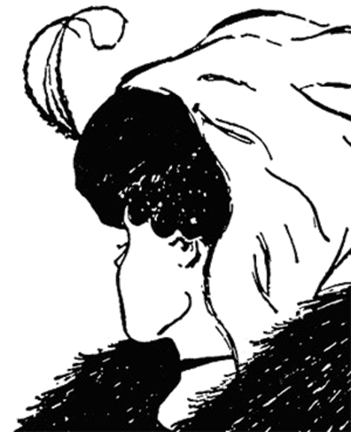

Slide 6


Slide 7
Cognitive biases – subconscious worldviews
We see what we expect to see
Motivated biases – emotional rationalizations
We see what we want to see
Past and personal experience form positive/negative preferences

Slide 8
Certainty
Def: The acceptance of fact without doubt
True knowledge
Objective certainty (scientific fact) vs. subjective certainty (belief)
What are we certain of?
How do we know?

Slide 9


Slide 10

Notes:
Red-blind protanopia (colorblindness)

Slide 11
If we don’t have all the info, misperceive what info we have, and can’t be certain, how do we make good decisions?
We can only try to overcome these obstacles
Examine historical relationships
Acknowledge bias
Interpret signals and motivations
Evaluate capability and credibility
Strategic reasoning: costs, benefits, consequences

Slide 12
Historical relationships
Our perception of “others” derives from mutual history
Past conflict → we believe current threats
Past cooperation → we believe current promises
Honesty and bluffing behaviors

Slide 13
Acknowledge bias
To properly assess reality, we have to be aware of our own perceptions of reality
Recognize biases and preferences and try to understand other side
Then examine why we hold those biases and whether they accurately reflect the info we have

Slide 14
Signals and motivations
To overcome info problems, we send each other signals and try to persuade others of our motives
Must interpret
Some are nothing but “cheap talk” → how do we know if they’re legit?
Actions speak louder than words

Slide 15
Capability and credibility
Capability – can they do what they say?
Credibility – will they do what they say?
Increased by:
Capability
Reputation for honesty
Value of the issue
Costly signaling

Slide 16
Strategic reasoning
Chess match mentality – think multiple moves ahead
Make contingency plans
Maximize utility – highest payoff at the lowest cost
Realize that both sides are attempting this

